Slide 1
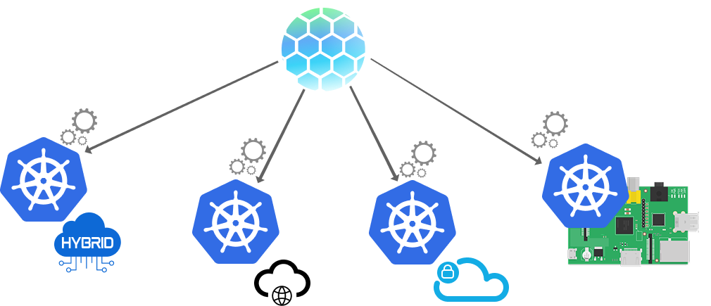
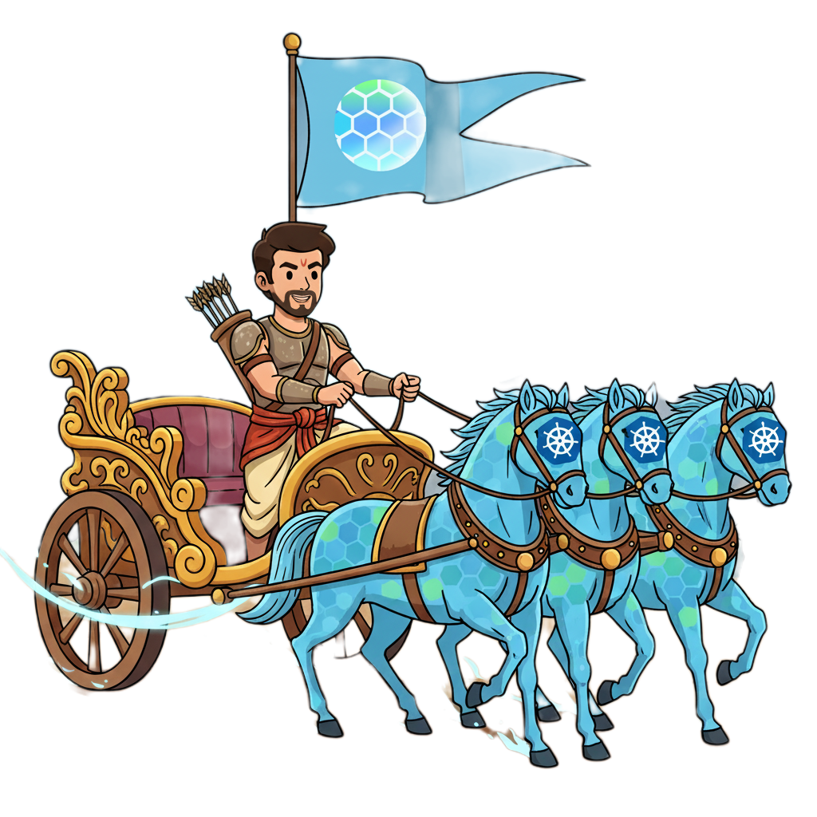
Kubestellar:
Managing multiple clusters

Slide 3
I am Rishi Mondal
Mantiner of cncf kubestellar
Docker Captain
LFX mentor / mentee
Research Intern at University of California
GSOC 24,25 UC OSPO
Lift Scholar
Intel Student Ambassador
X Program Manager of GirlScript Foundation
Intern IIJ Japan
Currently pursuing BCA

Slide 4
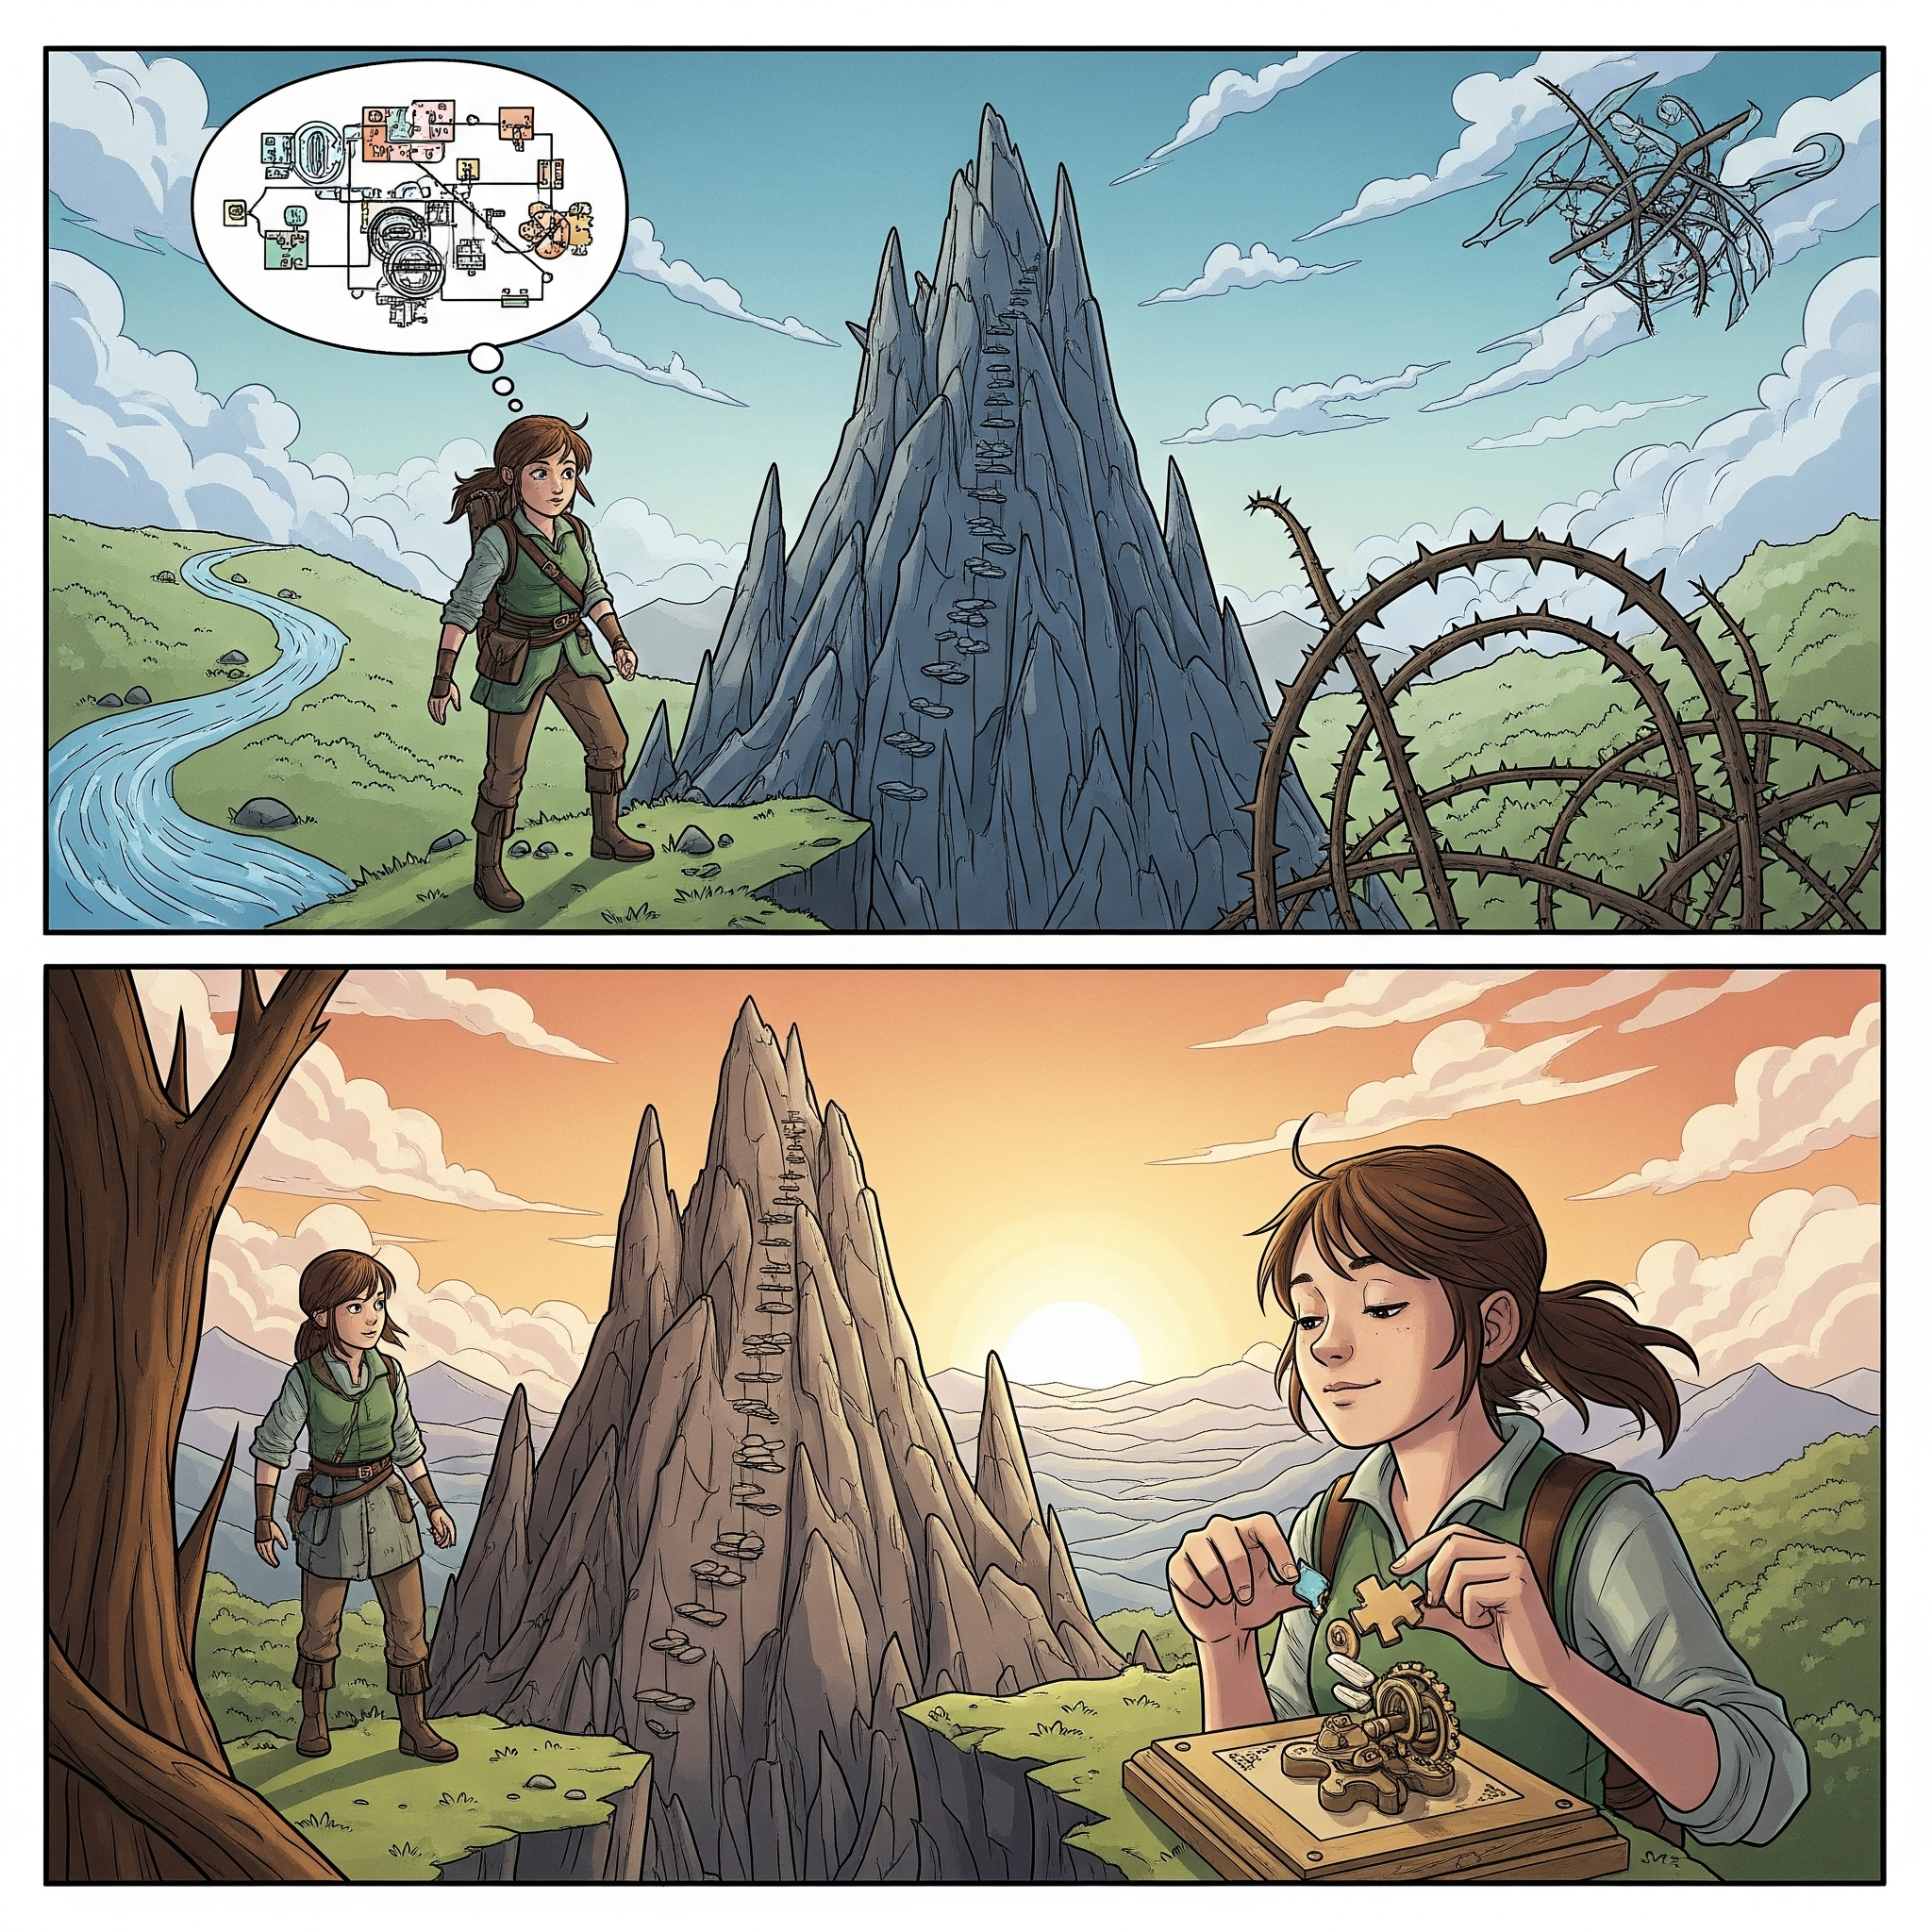
Story Time

Slide 5
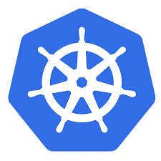

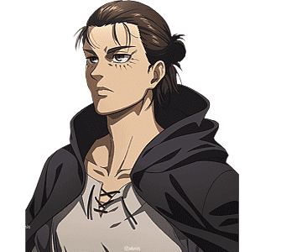

Year 2025. After defeating all titans, Eren Yeager became a DevOps engineer. He managed one peaceful Kubernetes cluster behind Wall Firewall. Life was simple.
Tatakae
One cluster. One config. Just like one titan at a time
Eren! We need 17 clusters worldwide!

Slide 6
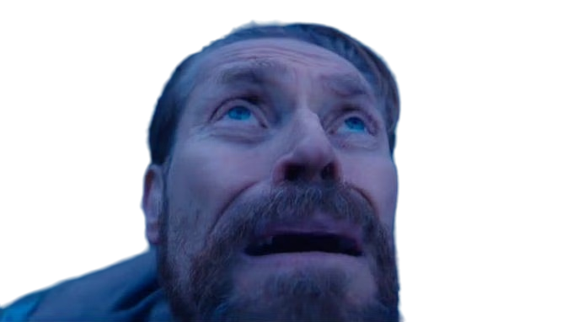

Slide 8
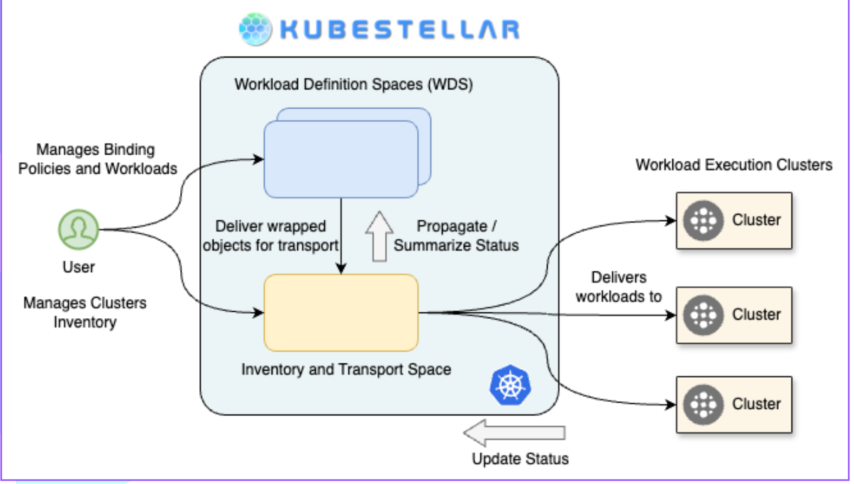

Slide 9
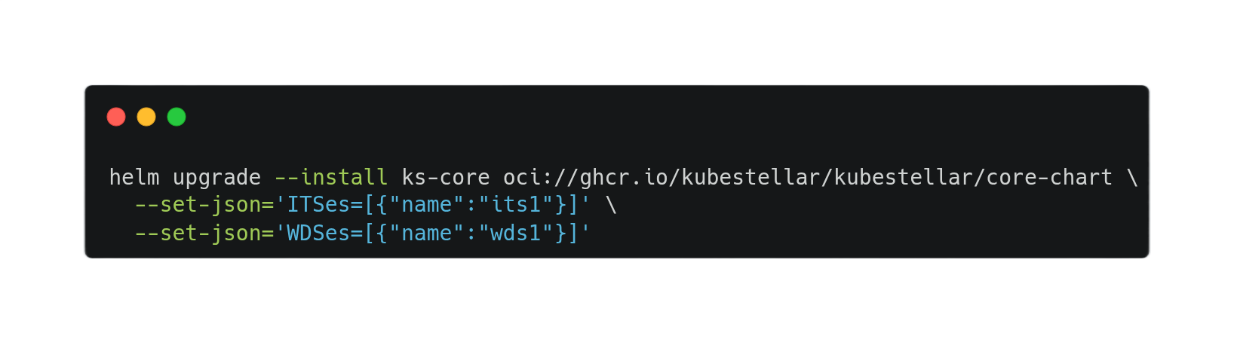
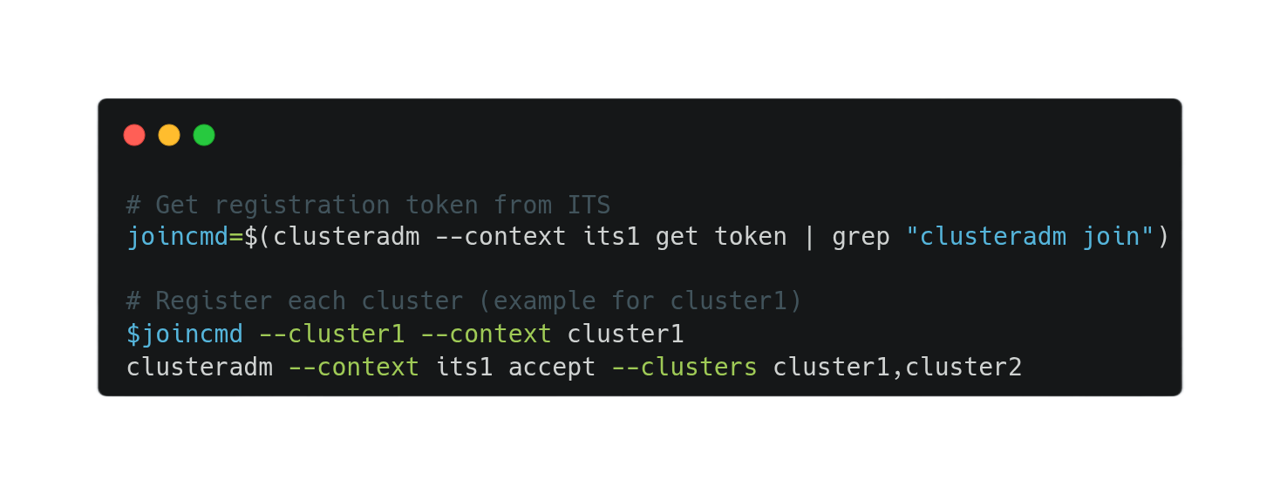
Create the central management hub
Connect AWS EKS, Azure AKS, Google GKE, and Edge clusters

Slide 10
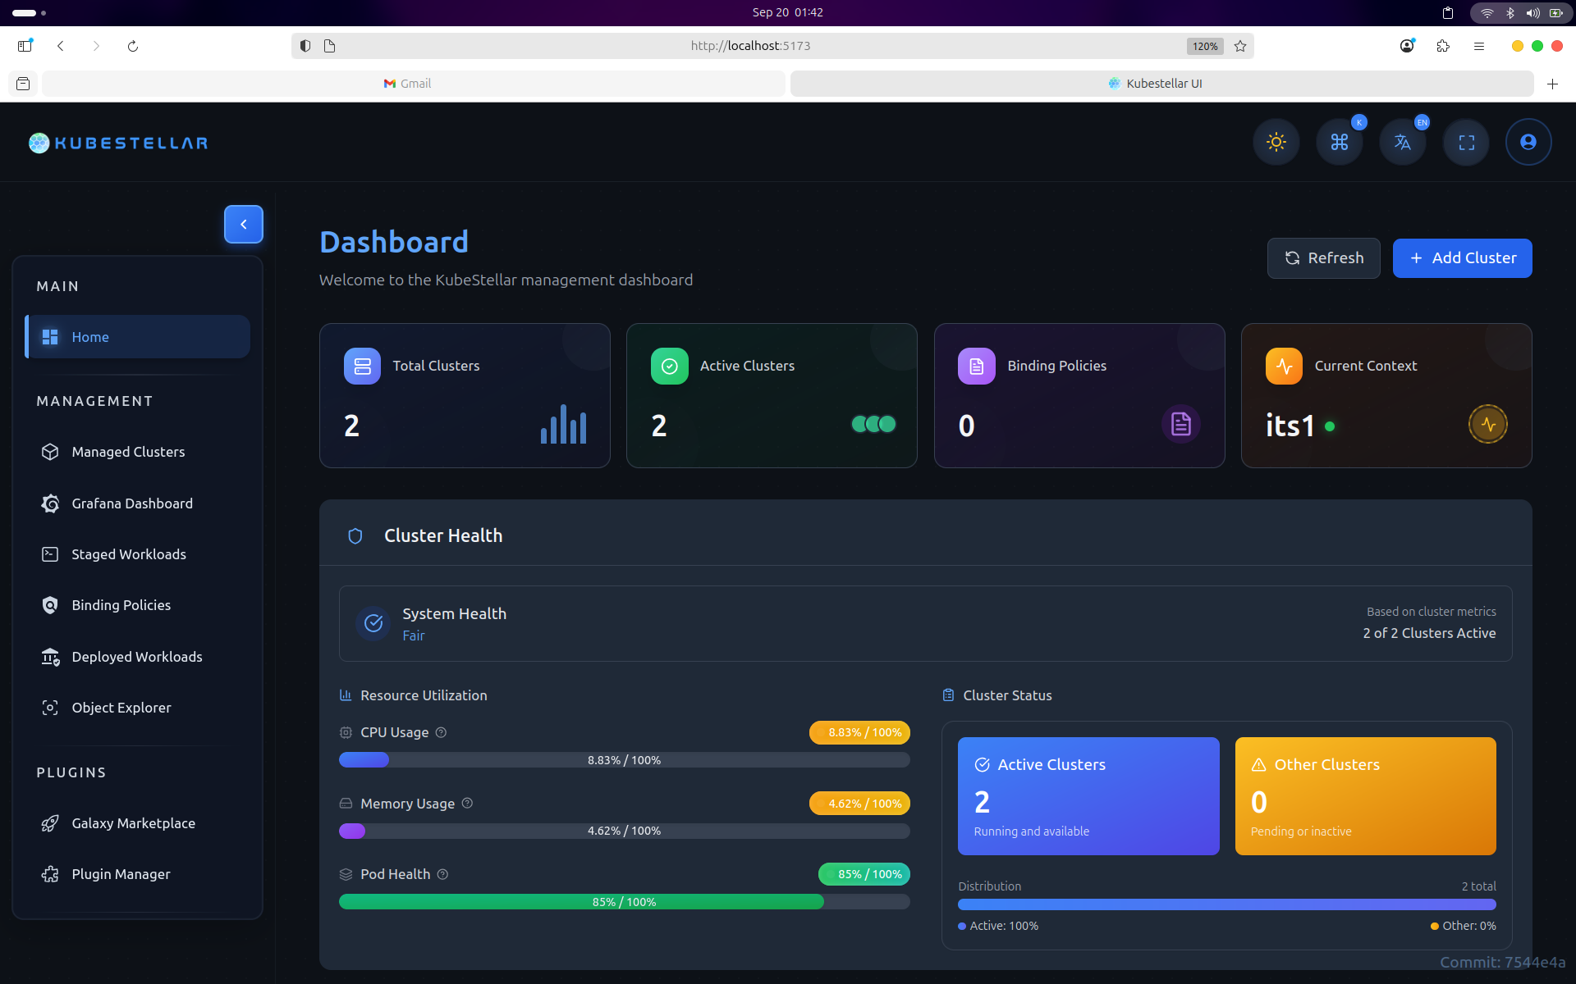

Slide 11
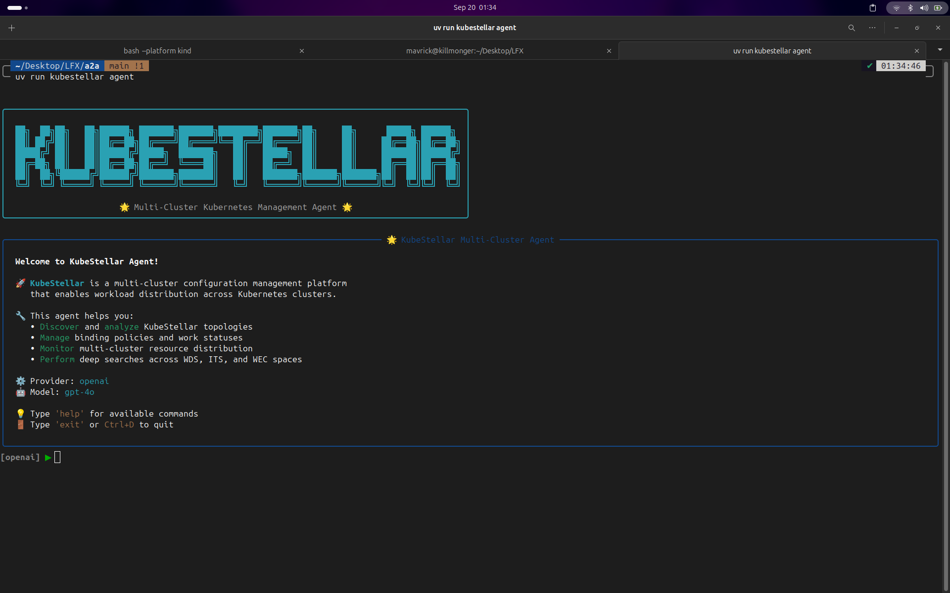

Slide 12
Congratulation
Congratulation you can write 10 yrs experience on kubestellar in your bio and CV

Slide 13
Internship and Mentorship opportunity
IFOS
GSOC
LFX
ESOC
Kubestellar internship (IFOS)

Slide 14


Slide 15

Connect With me

